Slide 1
Interrupts
Microprocessor and Interfacing 261214

Slide 2
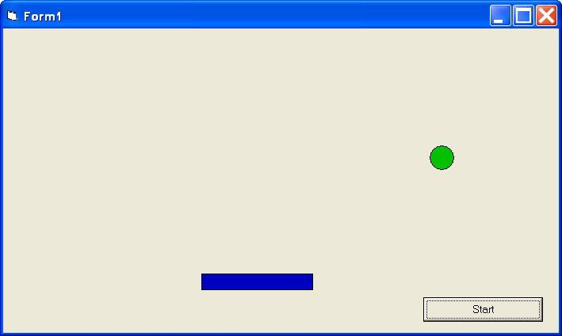
Example: Writing a Game
Need to Check Keyboard Input

Slide 3
Method 1: Using a Loop Program keeps checking for keyboard input
While (1) [
If Key = Right Then
moveRight
ElseIf Key = Left Then
moveLeft
End If
]

Slide 4
Mothod II: Use KeyPress Event Runs only when there is a keyboard interrupt
KeyPressEvent(Key)
If Key = Left Then
MoveLeft
ElseIf Key = Right Then
MoveRight
End If
End Subroutine

Slide 5
What’s the Difference Between Method I - Method II ?

Slide 6
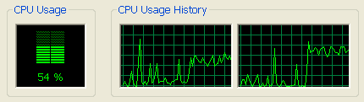
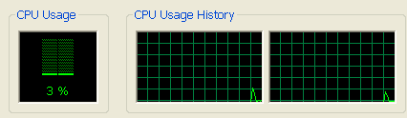
Method I : Software Polling
Method II : Event or Interrupt Driven

Slide 7
I/O Handling Techniques
Software Polling Use code to keep checking for the desired event
Interrupts Code triggered only when a desired event takes place
Direct Memory Access (DMA) I/O is handled with minimal CPU involvement

Slide 8
Benefits of Using Interrupts
Consumes much less CPU
Especially when interrupt generated by hardware
Cleaner & Simpler Code
Allows Basic Parallel Processing

Slide 9
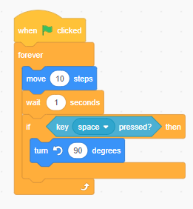

Case Study I
This code tries to: - Move the sprite every 1 seconds
- Turn the sprite every time “space bar” is pressed
But there is a problem. The sprite doesn’t always turn
Try it on Scratch

Slide 10
Problem: This if is executed only once every second.
Fix: we need it to be more responsive

Slide 11
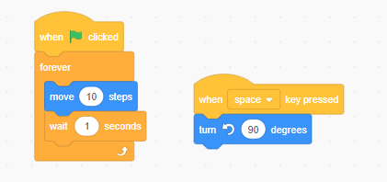
Fix1: Use “event” instead of polling

Slide 12
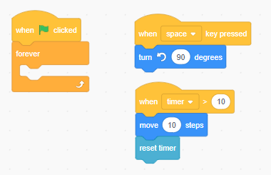
Using “events” only with nothing left in the main loop

Slide 13
Case Study 2: MCU Code
This code tries to
Blink an LED every 0.5 sec
Also receives serial data from the computer
What’s wrong with this program?
While (1) {
output_toggle(LED);
delay_ms(500);
data = getchar();
}

Slide 14
Blocking I/O Operations
While (1) {
output_toggle(LED);
delay_ms(500);
data = getchar();
}
Blocking I/O until delay is complete
Blocking I/O until a character is received

Slide 15
Same Program with Timer Interrupt
timerISR() {
output_toggle(LED);
}
Main() {
setupTimer();
while (1) {
data = getchar();
}
}

Slide 16
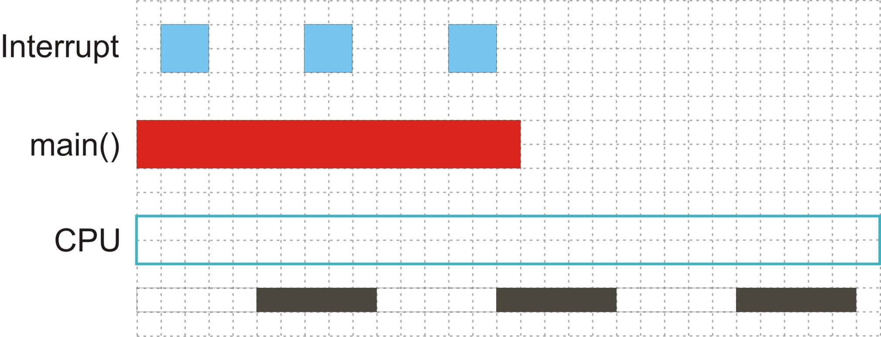
Interrupt Handling

Slide 17
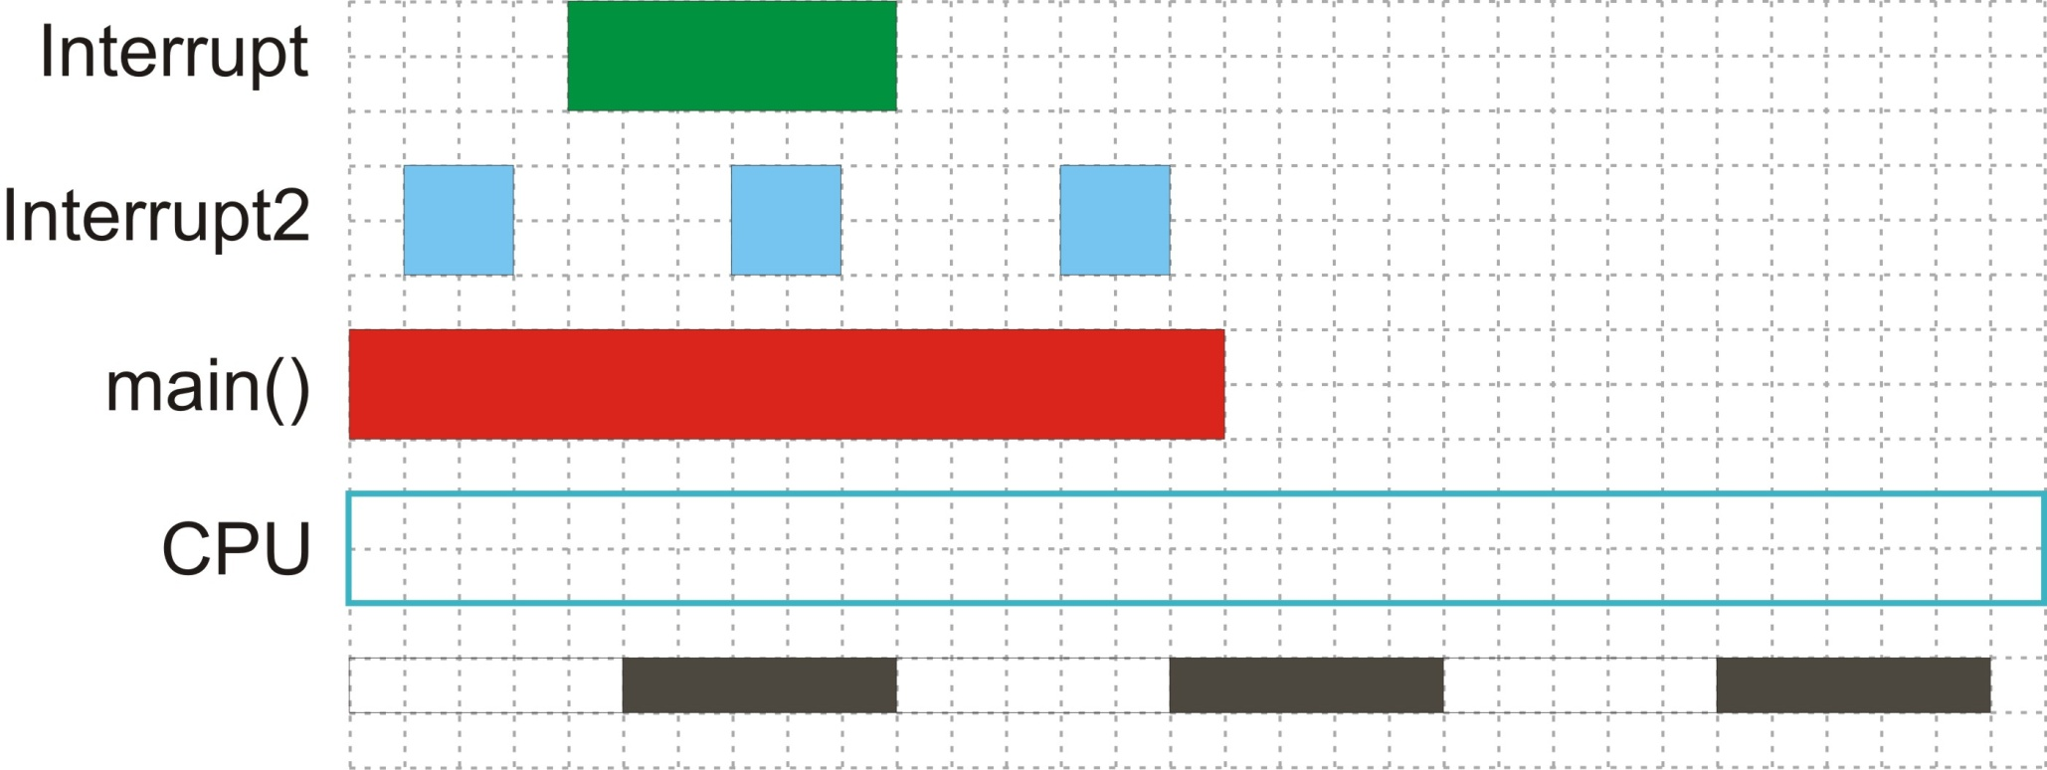
Multi-Interrupt Handling

Slide 18
Important Note: Must minimize the time an ISR takes to execute
Interrupts should perform as little work as possible.
Should not call I/O functions
Keyboard input – getchar(), scanf()
I2C commands
Read sensor
Should not call delay functions
Delay_ms(), Dealy_us()

Slide 19
Useful technique: Asynchronous Execution
Example of a BAD interrupt code design:
timerISR() {
output_high(LED);
delay_ms(1000);
output_low(LED);
}
Main() {
setupTimer();
while (1) {
// do main work
}
}
ISR includes a long delay

Slide 20
After using Asynchronous Execution: Execution Moved to main()
int1 doBlink = 0;
timerISR() {
doBlink = 1;
}
Main() {
setupTimer();
while (1) {
// do main work
if (doBlink == 1){
output_high(LED);
delay_ms(1000);
output_low(LED);
doBlink = 0;
}
}
}

Slide 21
Exercise: Use Asynchronous Execution to fix this program
IO_ISR() {
ss = readSensor(1);
printf(“%ld\r\n”, ss);
}
Main() {
setup_IO_Interrupt();
while (1) {
// do main work
}
}
IO interrupts happen when the user presses a button connected
to a micro-controller

